Slide 1
Understanding “Action/Reaction Pairs”
Always between two different objects!!!

Slide 2
Newton’s 3rd Law
While one object is exerting a force on another…the other is ALWAYS exerting a force back that has the SAME MAGNITUDE but OPPOSITE DIRECTION:
FAB means force from A on B

Slide 3
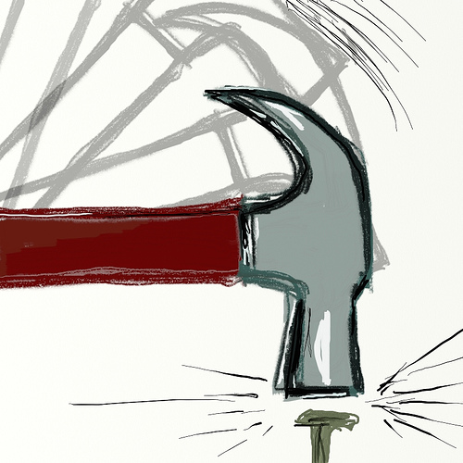
F_{NH}
F_{HN}

Slide 4
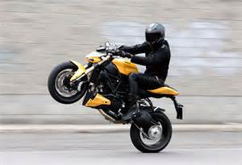
f_{RT}
f_{TR}

Slide 5
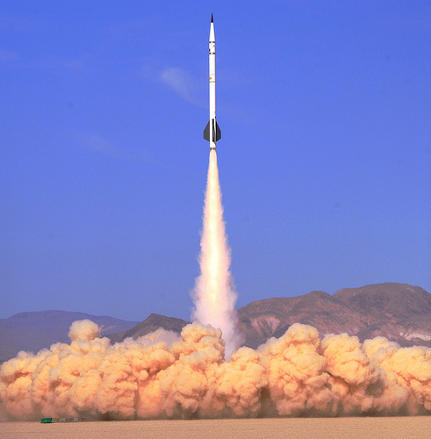
F_{GR}
F_{RG}

Slide 6
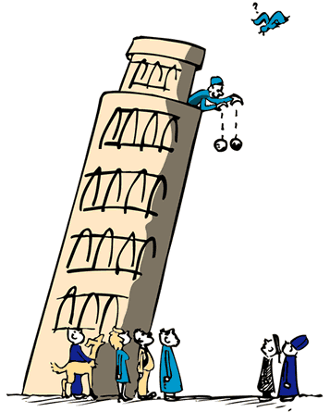
Fg_{EB}
Fg_{BE}

Slide 7
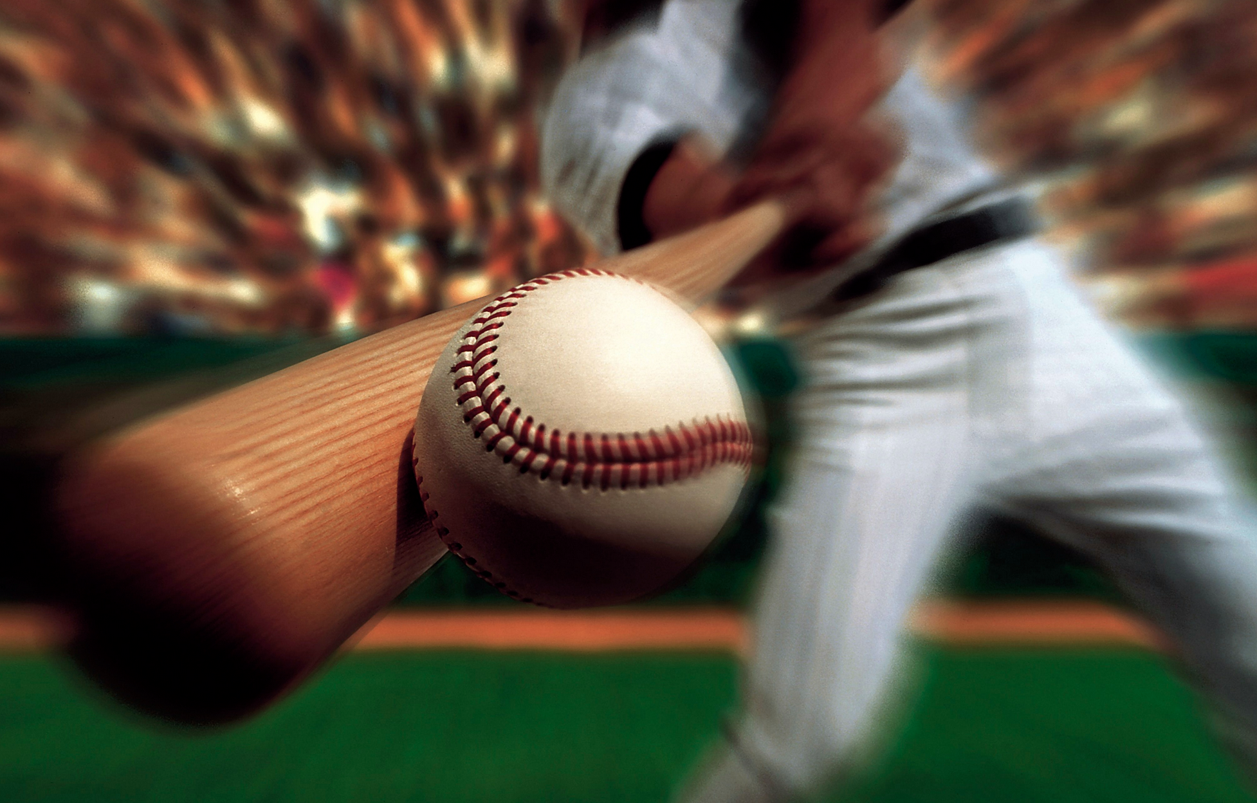
F_{BatBall}
F_{BallBat}

Slide 8
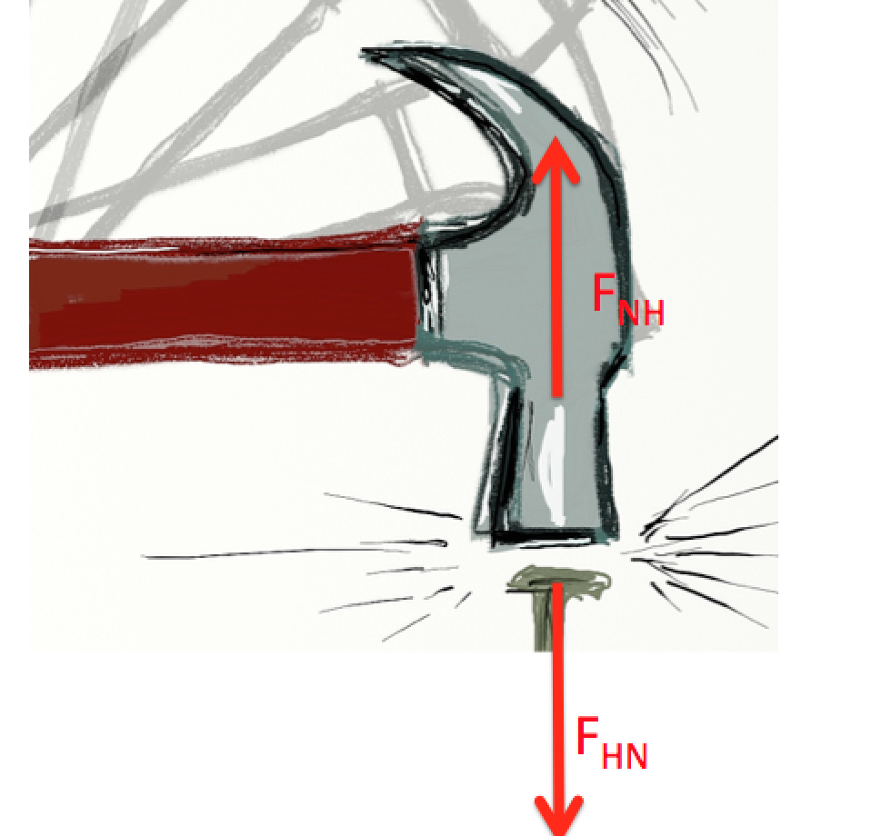
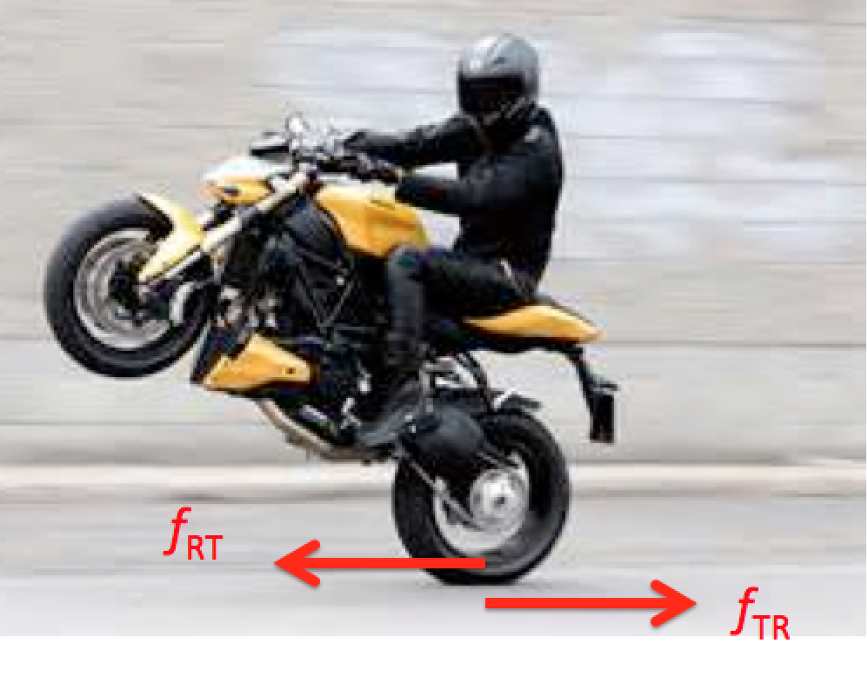
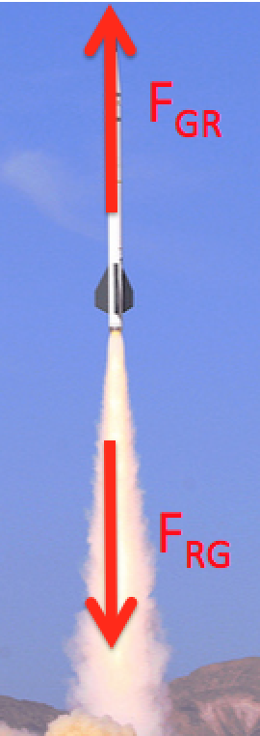
Don’t Equal and Opposite Forces Add to Zero?!
They don’t cancel since they act on DIFFERENT objects…
Nail Accelerates Downwards,
Hammer Upwards
Bike Accelerates to the Left,
Earth to the Right
Rocket Accelerates Upwards,
Gas Downwards

Slide 9
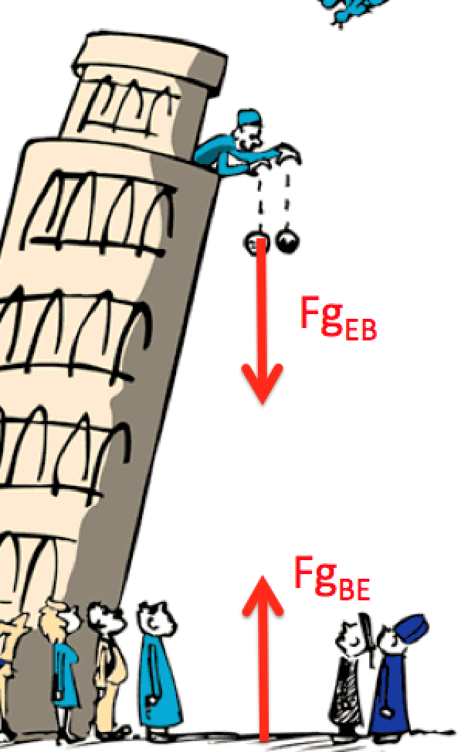
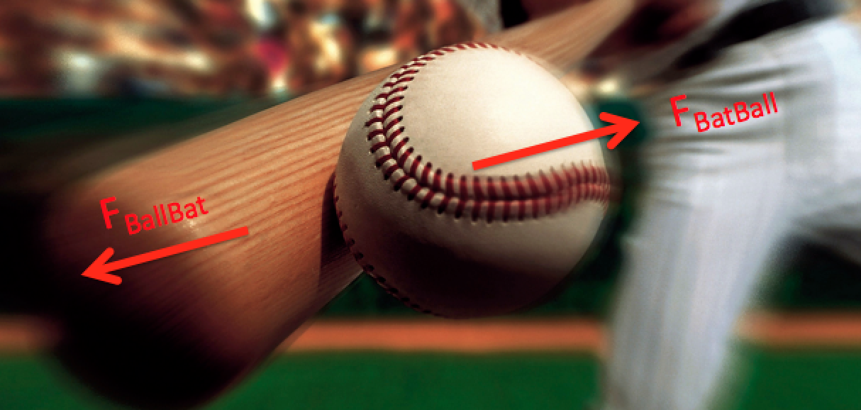
They don’t cancel since they act on DIFFERENT objects…
Cannonball Accelerates Downwards,
Earth Accelerates Upwards
Baseball Accelerates Up and to the Right,
Bat Accelerates Down and to the Left

Slide 10
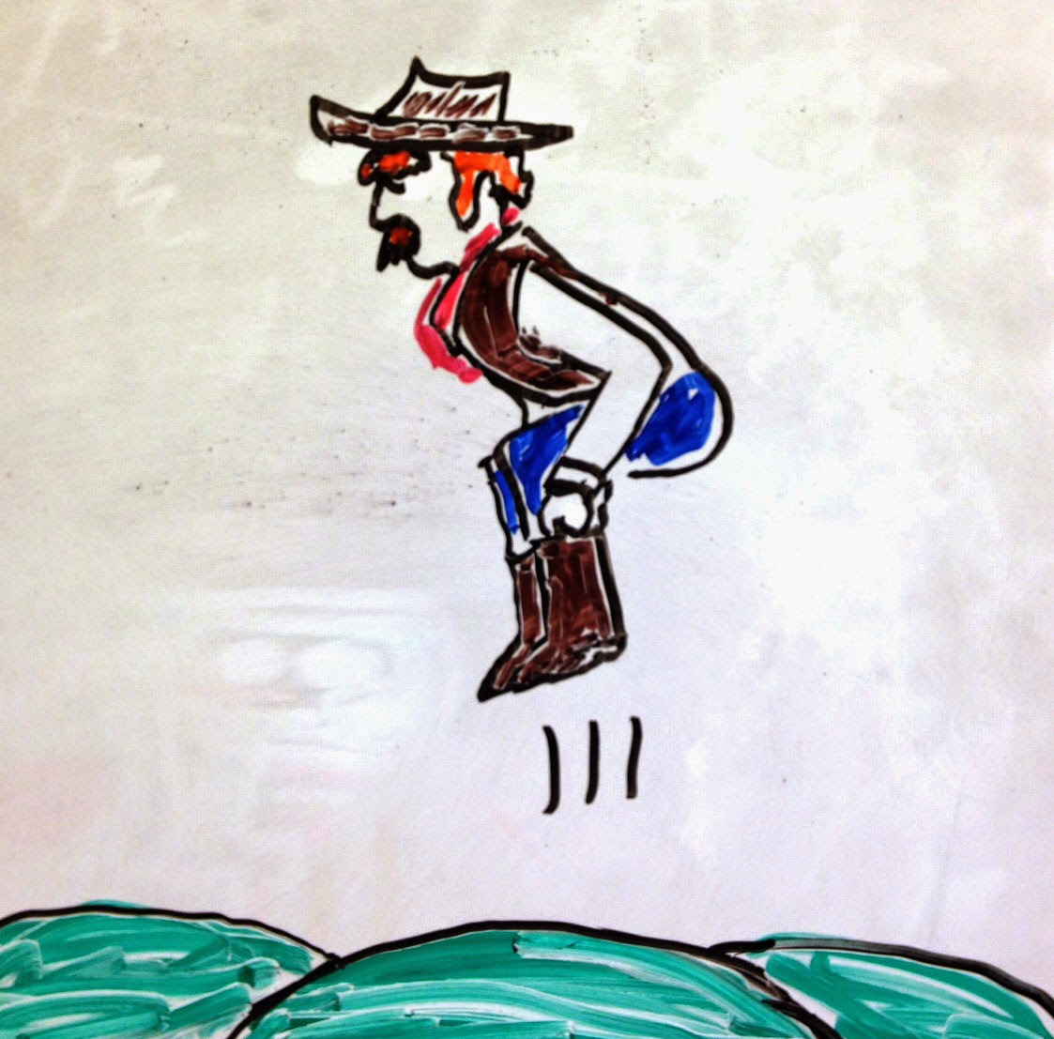
However… they kinda do cancel if the forces are “INTERNAL”
“Pick yourself up by your bootstraps”?
F_{HB}
?
F_{BH}
Since the BOOTS and the HANDS are attached to the same object, in the FBD for the cowboy they will cancel!

Slide 11
If the forces are the SAME size…then why do the objects move so differently?
According to Newton’s 2nd Law:
Therefore, for a given force, the object with the SMALLER MASS will have a LARGER ACCELERATION

Slide 12
Which object accelerates more?

Slide 13
Can you use Newton’s 3rd Law to Explain the Following?

Slide 14
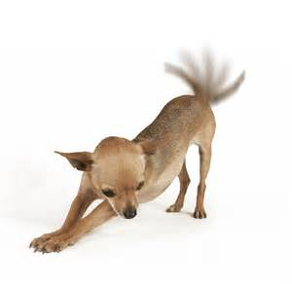
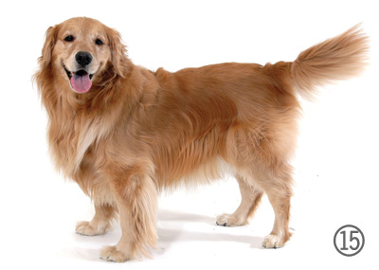
What happens to a dog’s body when it wags its tail?

Slide 15
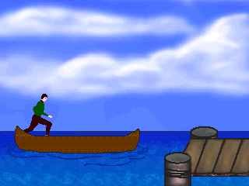
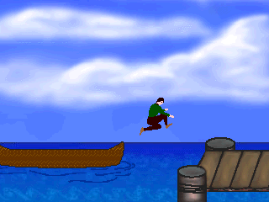
What happens if you try to jump from a canoe to a dock?

Slide 16
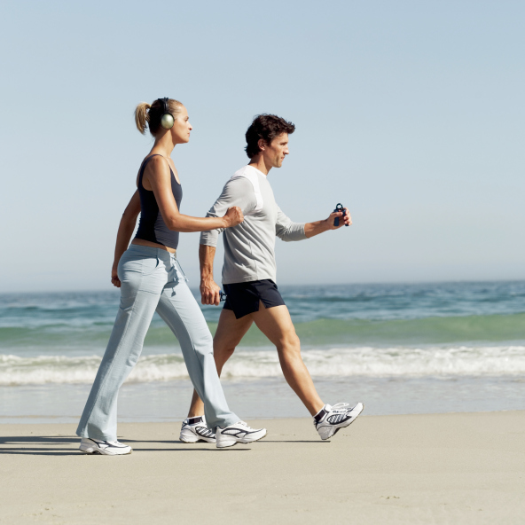
Why does walking require Newton’s 3rd Law?

Slide 17
Why should you wear eye protection when shooting?

Slide 18
Can you figure out ALL the pairs?

Slide 19
3 Objects
G = Guy
B = Box
E = Earth
Gravity
Normal
Fa_{BG}
Applied
Fa_{GB}
Fg_{EB}
Friction
Fg_{EG}
Fn_{EB}
Fn_{EG}
f_{EB}
f_{EG}
f_{GE}
f_{BE}
Fn_{GE}
Fg_{BE}
Fg_{GE}
Fn_{BE}

Slide 20
3 Objects
G = Guy
B = Box
E = Earth
FBD for Box
FBD for Guy
Gravity
Normal
Fa_{BG}
Applied
Fa_{GB}
Fg_{EB}
Friction
Fg_{EG}
Fn_{EB}
Fn_{EG}
f_{EB}
FBD for Earth
f_{EG}
f_{GE}
f_{BE}
Fn_{GE}
Fg_{BE}
Fg_{GE}
Fn_{BE}

